Slide 1
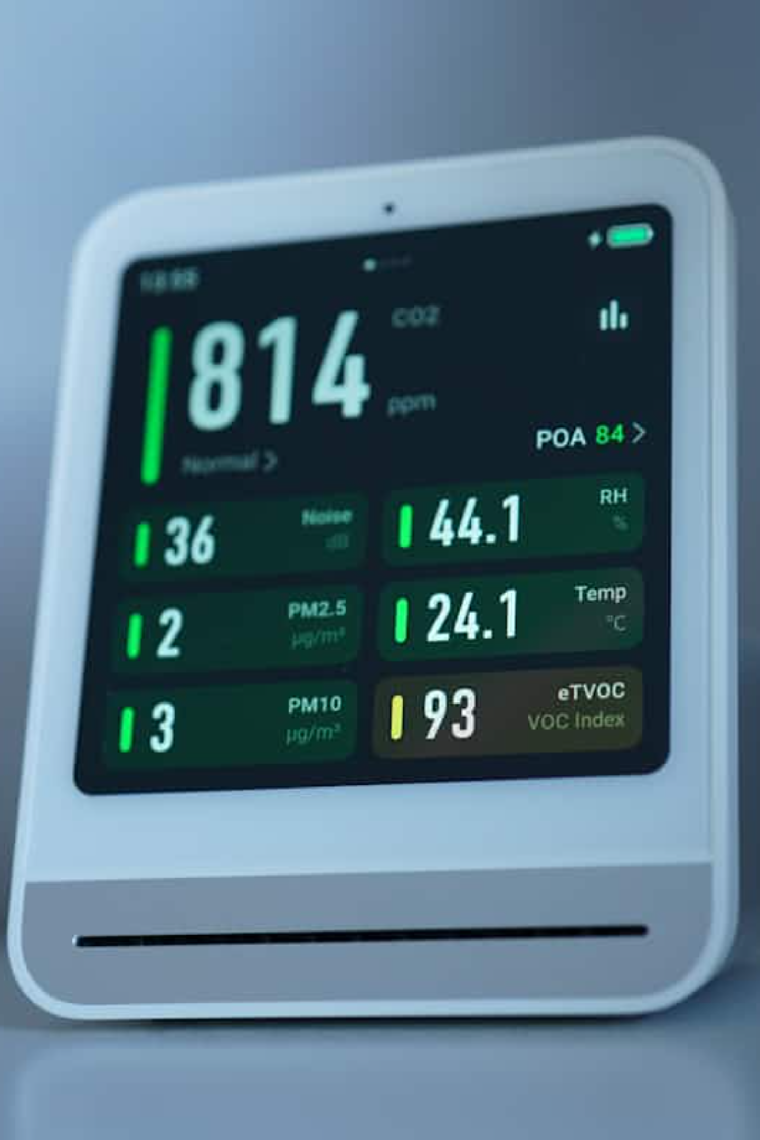
RAG-Based Medical Diagnostic System
A sophisticated diagnostic assistant combining workflow automation, vector-based semantic retrieval, and generative AI to deliver accurate medical insights in real time.

Slide 2
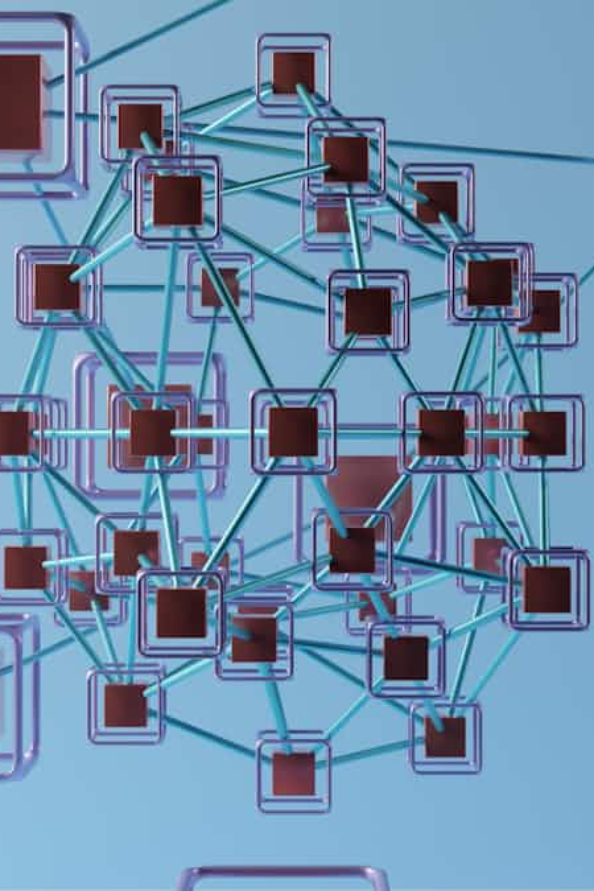


System Architecture Overview
Ingestion Pipeline
Processes medical data and converts it into vector embeddings stored in Supabase for semantic search.
Retrieval Pipeline
Executes when users enter symptoms, retrieving similar entries and generating diagnostic recommendations via LLM.
Built on n8n for workflow automation, Supabase for vector search, and Node.js/Vite for the user interface—ensuring seamless communication between frontend, automation engine, and AI components.

Slide 3
Data Foundation
Structured Dataset
Disease
Symptoms
The system relies on a standardized CSV file containing cleaned and preprocessed medical data.
Medical condition name
Common symptoms associated with the disease
This consistent schema enables efficient semantic search during retrieval.
Diagnostic Measures
Recommended medical tests for confirmation

Slide 4


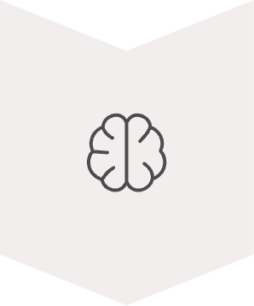

Ingestion Pipeline: Data to Embeddings
CSV Input
Preprocessed medical data loaded into workflow
Embedding Generation
Text converted to dense vector representations
Vector Storage
Embeddings stored in Supabase pgvector
n8n orchestrates the entire workflow in Docker, ensuring consistency during embedding and enabling fast semantic search in the retrieval stage.

Slide 5

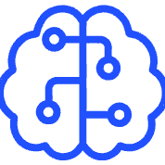

Ingestion Components
n8n Automation
Embedding Model
Supabase pgvector
Dockerized workflow engine orchestrating ingestion processes and managing component connections.
Converts disease and symptom text into semantic vectors capturing medical meaning.
Stores embeddings and original text for fast, accurate similarity searches.

Slide 6
User Journey: From Symptoms to Diagnosis
User Input
1
Patient enters symptoms via web chatbot interface
2
Webhook Trigger
Node.js backend sends input to n8n workflow
Vector Search
3
Query embedded and matched against database
4
LLM Generation
AI produces diagnostic recommendation
Response Display
5
Result shown to user in natural language

Slide 7
Retrieval Pipeline Deep Dive
01
02
03
Query Embedding
Semantic Search
Context Compilation
User symptoms converted to vector using same model from ingestion stage
k-NN search in Supabase retrieves top matching symptom patterns
Retrieved entries (Disease, Symptoms, Diagnostic Measures) assembled into context block
04
05
LLM Processing
Response Delivery
Context and query passed to LLM via structured prompt for diagnosis generation
Generated text returned through webhook to frontend for display

Slide 8
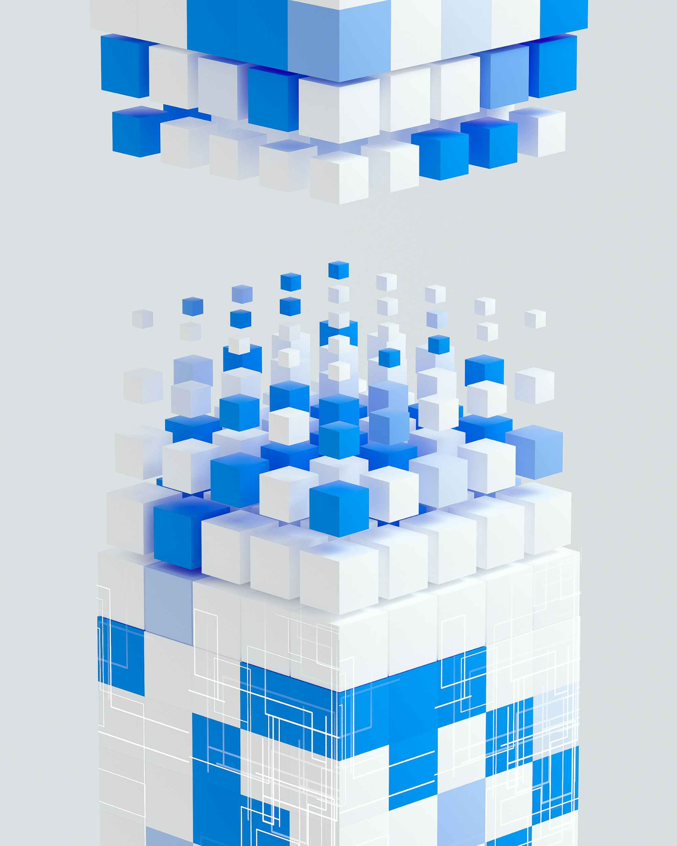
Technical Stack
Data Layer
Structured CSV (preprocessed.csv) with diseases, symptoms, and diagnostics
Automation
n8n running in Docker for workflow orchestration
Vector Database
Supabase with pgvector extension for semantic similarity searches
Frontend
Node.js and Vite for user interaction and API communication
AI Components
Embedding model and LLM for semantic understanding and generation

Slide 9
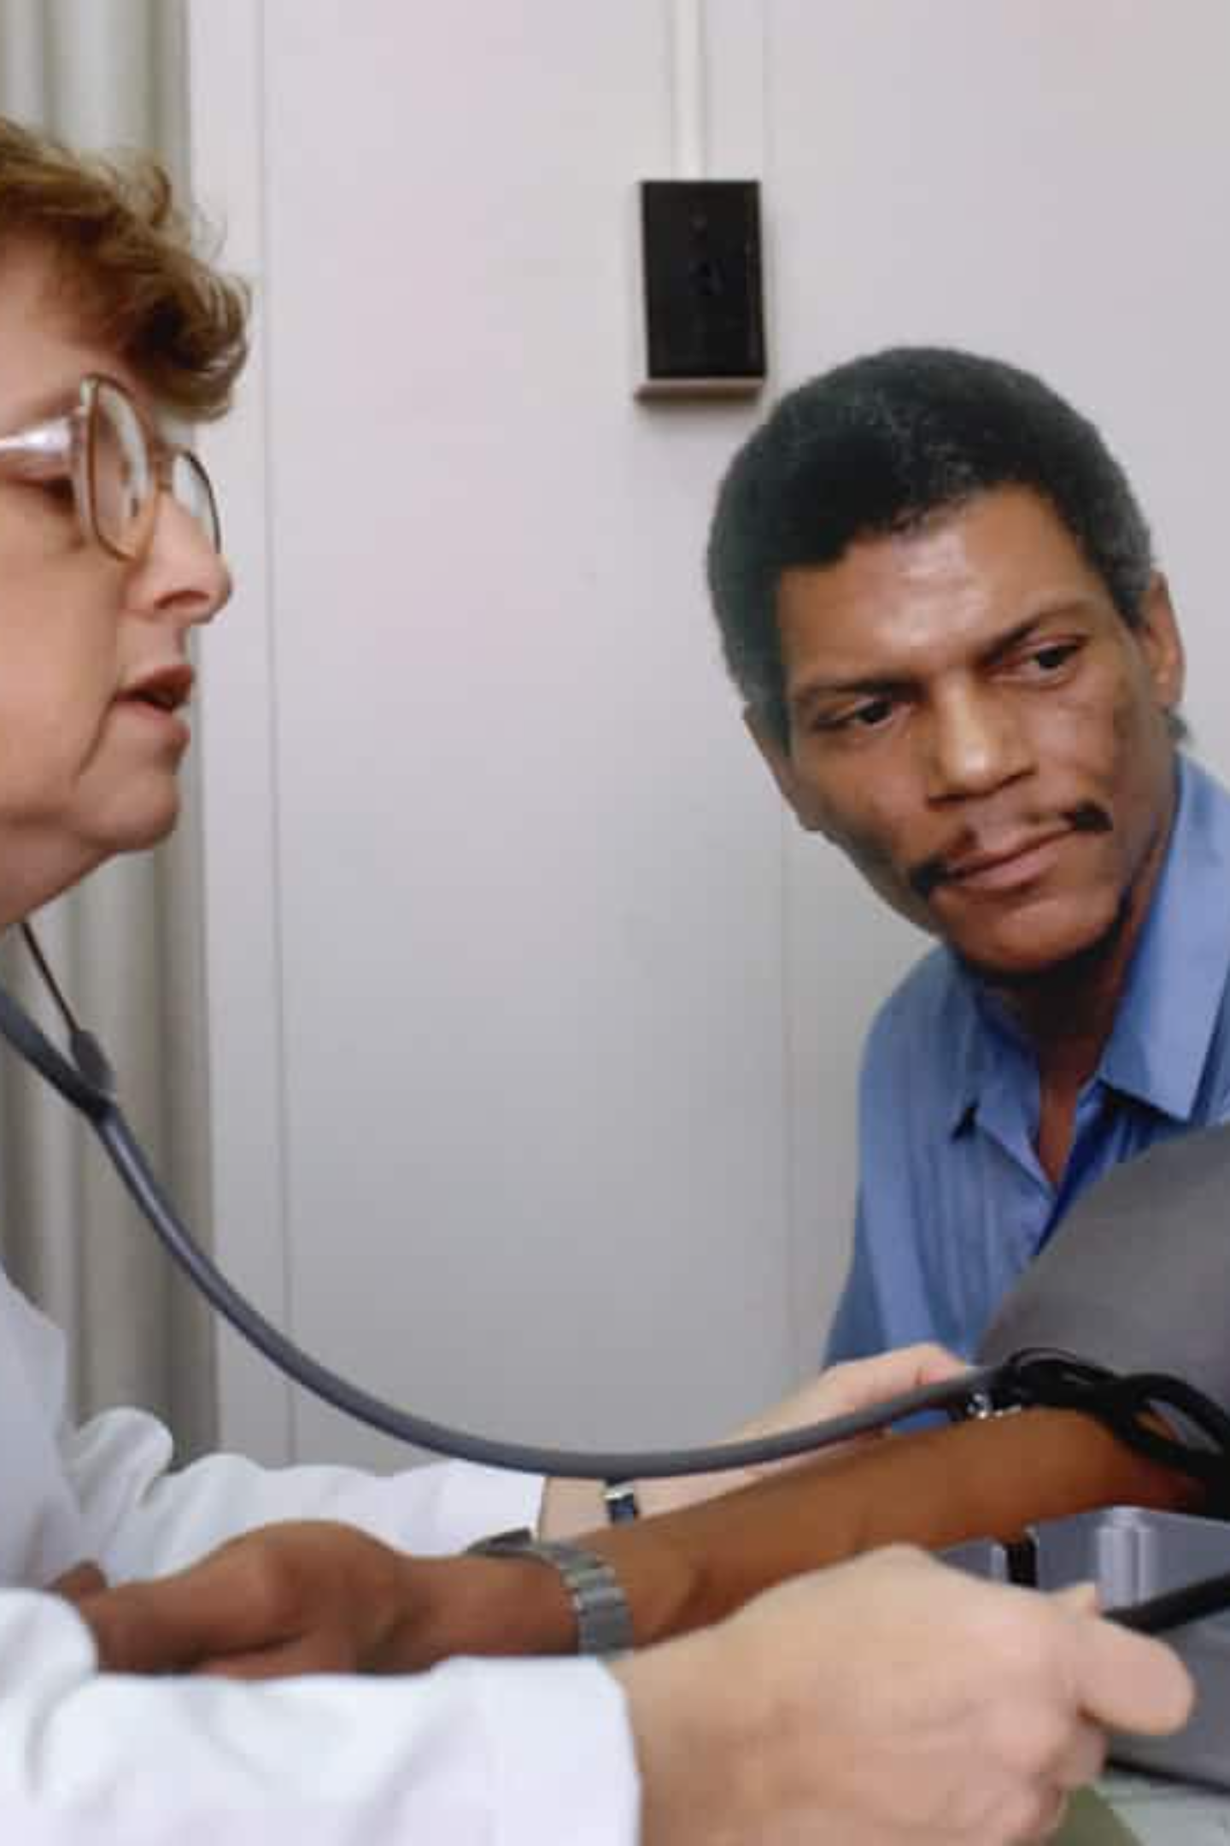
System Benefits
Fast Response
Contextually Intelligent
Real-time diagnostic insights delivered through optimized vector search and AI generation.
Semantic understanding ensures recommendations are grounded in relevant medical knowledge.
Scalable Architecture
Docker containerization and cloud database enable easy expansion and maintenance.

Slide 10
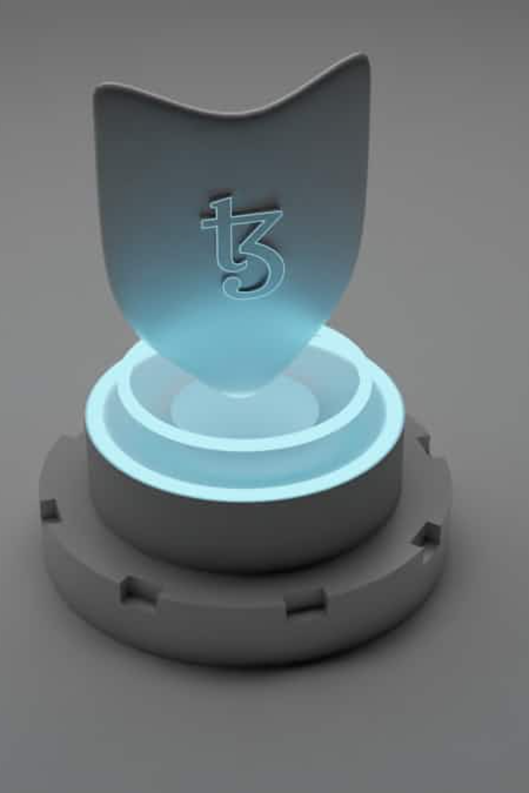
The Complete Picture
This RAG-based system combines workflow automation, vector-based semantic retrieval, and generative AI to deliver medical diagnostic insights.
Ingestion pipeline ensures data is properly structured and embedded
Retrieval pipeline dynamically interprets user symptoms
System produces contextually grounded, human-readable diagnostic recommendations

